Slide 1

Java code summarizer using abstract syntax tree
BY,
KUMUDA BENAKANAHALLI GURUPRASADA MURTHY
kumuda.benakanahalliguruprasadamurt@sjsu.edu

Slide 2

Pain Points while coding
Photo courtesy: Medium.com

Slide 3

WHY CODE COMMENT
Photo courtesy: pjsandpaint.com

Slide 4
SOLUTION
Combination of Deep Learning model and Abstract Syntax Tree(AST)

Slide 5
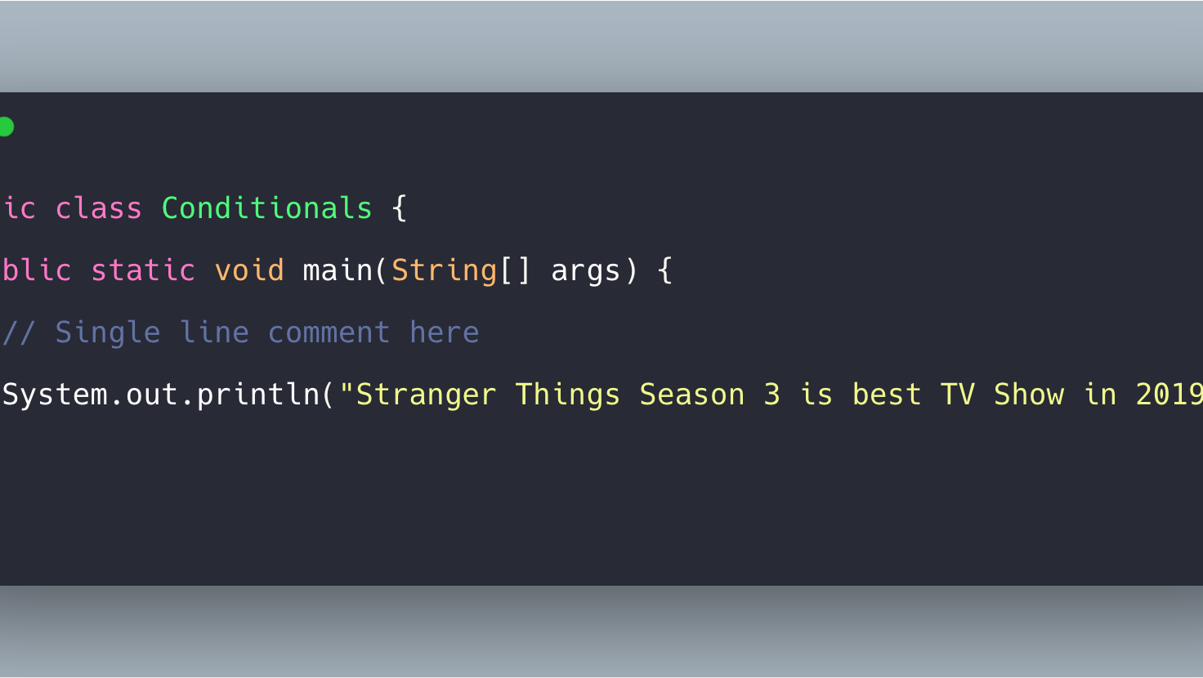
DATASET

Slide 6
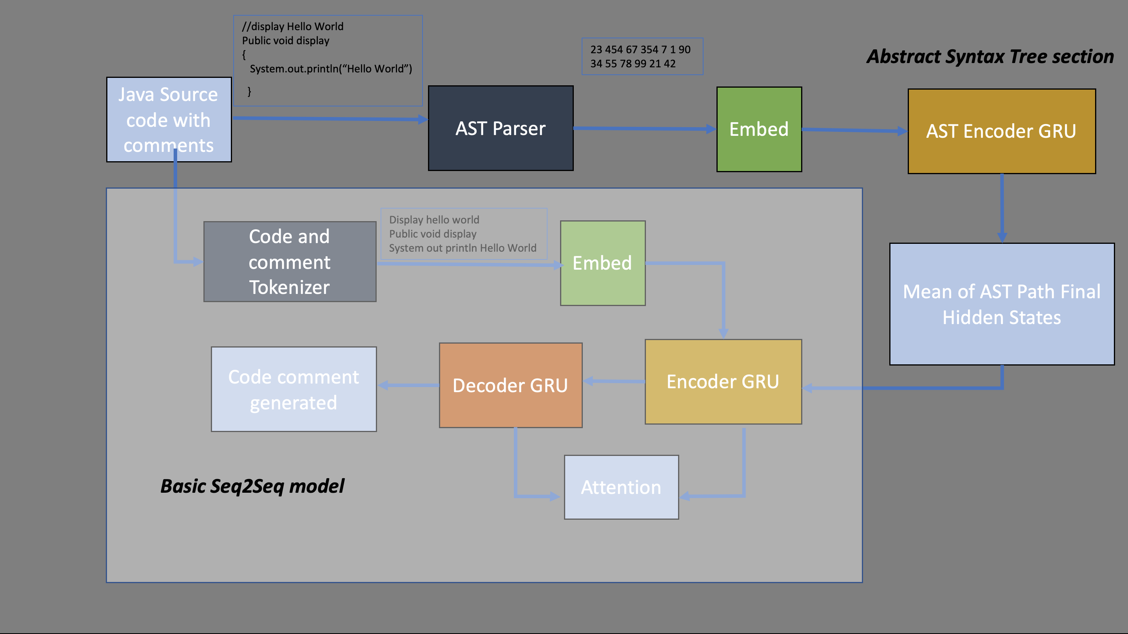
SYSTEM ARCHITECTURE

Slide 7
Experiment Results
MODEL | BLEU SCORE
Seq2Seq model (SOTA) | 34.78%
Seq2Seq with AST | 39.17%

Slide 8
CONCLUSIOn

